Slide 1
Analyze k-mers for genomic profile
NIG/Sokendai Genome Informatics Laboratory
ChunHsuan Lo (Jason)
Notes:
The shape of the k-mer profile can directly reflects the complexity and many features of the genome.
Advantage:
k-mer profile can be computed without a reference genome by scanning the raw sequencing reads.
Therefore, this works well for novel genomes.

Slide 2
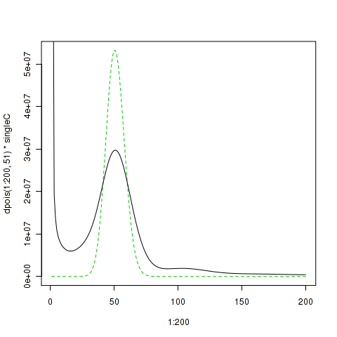
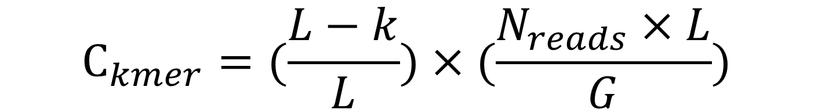
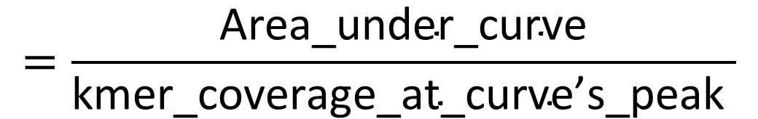
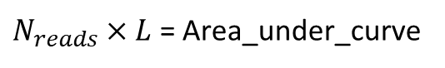
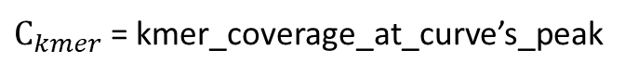
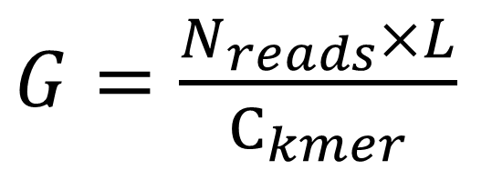
Formula for inferring genome’s size from kmer histogram:
When L>>K…
$$C_{kmer}=(\frac{L−k}{L})×(\frac{N_{reads}×L}{G})$$
Poisson distribution
(total number of k-mers with a given frequency)
Therefore…
$N_{reads}×L$ = Area_under_curve
$G=\frac{N_{reads}×L}{C_{kmer}}$
$$=\frac{\text{Area}\text{_}\text{under}\text{_}\text{curve}}{\text{kmer}\text{_}\text{coverage}\text{_}\text{at}\text{_}\text{curve}\text{’}\text{s}\text{_}\text{peak} }$$
(the frequency or the number of times a given k-mer is observed)
$C_{kmer}$ = kmer_coverage_at_curve’s_peak
Notes:
If a homozygous repeat-free genome has been sequenced without errors or biases to a given average coverage level (e.g. 100x coverage), then the k-mer profile will be a Poisson distribution, and the center of the distribution will appear at the average k-mer coverage. .(Kelley, et al., 2010; Lander and Waterman, 1988).
P.S. Here Ckmer is the average k-mer coverage, Nreads is the number of reads, L is the average read length, k is the length of the k-mer, and G is the genome size. This effectively shifts the peak down by k/L percent from the mean nucleotide coverage.

Slide 3
Using conventional method
Notes:
Tools:
Jellyfish (Marcais and Kingsford, 2011) -> to count k-mers directly from raw NGS reads.
R -> to visualize the k-mers distribution.

Slide 4
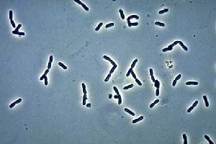
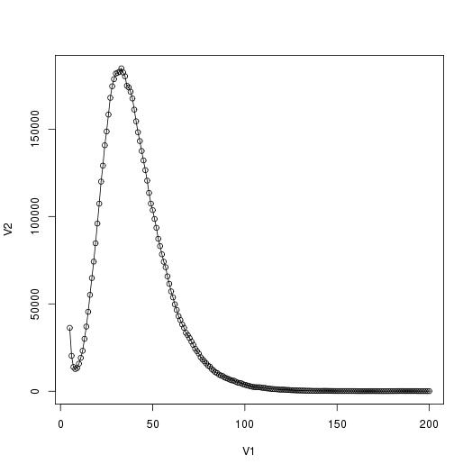
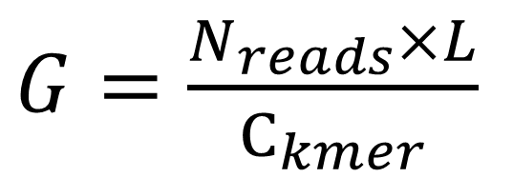
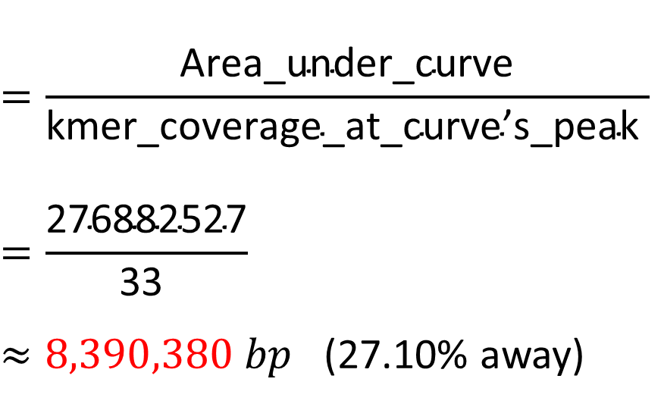

DRR021838 (Pseudomonas aeruginosa, 綠膿桿菌)
$G=\frac{N_{reads}×L}{C_{kmer}}$
(total number of k-mers with a given frequency)
Area_under_curve = 276882527
$$=\frac{\text{Area}\text{_}\text{under}\text{_}\text{curve}}{\text{kmer}\text{_}\text{coverage}\text{_}\text{at}\text{_}\text{curve}\text{’}\text{s}\text{_}\text{peak} }$$
$$=\frac{\text{276882527}}{\text{33} }$$
$≈8,390,380 bp$ (27.10% away)
(the frequency or the number of times a given k-mer is observed)
$$\text{kmer}\text{_}\text{coverage}\text{_}\text{at}\text{_}\text{curve}\text{’}\text{s}\text{_}\text{peak}=33$$
NCBI_genome: 6,601,410 bp
All NCBI data here shows “median total length”
Notes:
An illustration of k-mer histogram:
The x-axis, is the frequency or the number of times that a given k-mer is observed in the sequencing data.
The y-axis, is the total number of k-mers with a given frequency.
Here the NCBI_genome shows the “median total length”.

Slide 5
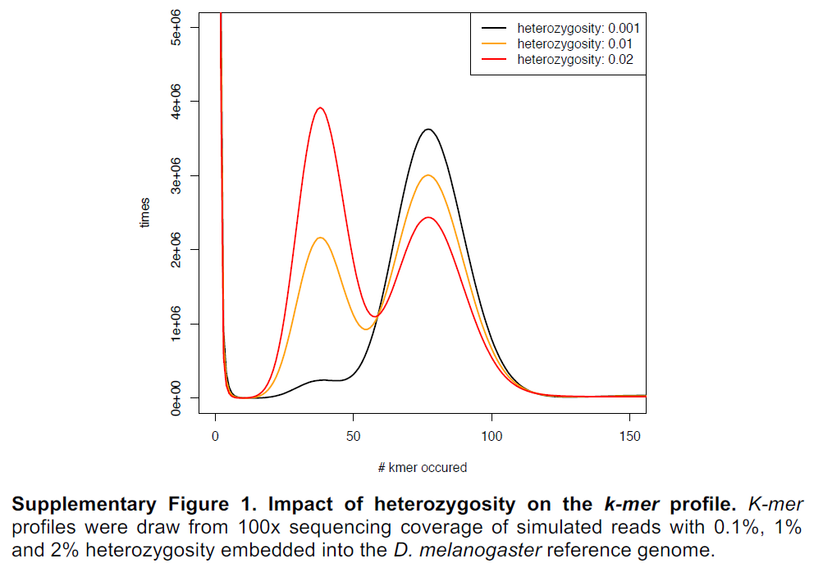
How genome’s heterozygosity impacts the peaks profile:
Erroneous k-mers
(from sequencing error)
Peak1
(from heterozygous)
Peak2
(from homozygous)
(total number of k-mers with a given frequency)
Hight repetitive k-mers
(from repeat sequence)
(X2 ≈ X1 * 2)
x1
x2
(the frequency or the number of times a given k-mer is observed)
Notes:
The first (heterozygous) peak and the second (homozygous) peak reflect genomic k-mers present in either one or both chromosome sets, which are shared by all reads sampled from the respective loci.
If the rate of heterozygosity rises, the peak1 becomes higher, and goes up very quick.

Slide 6
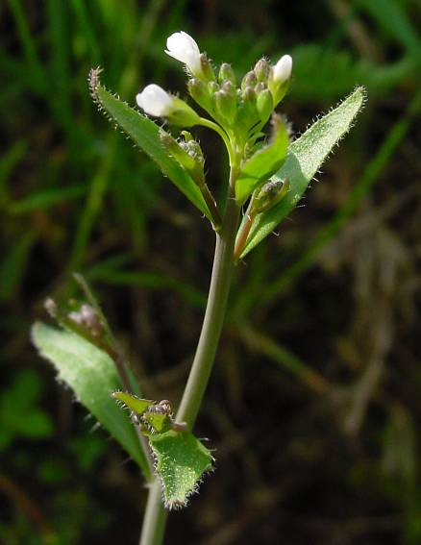
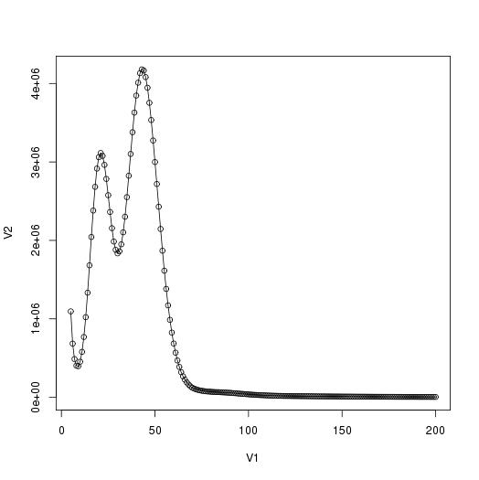
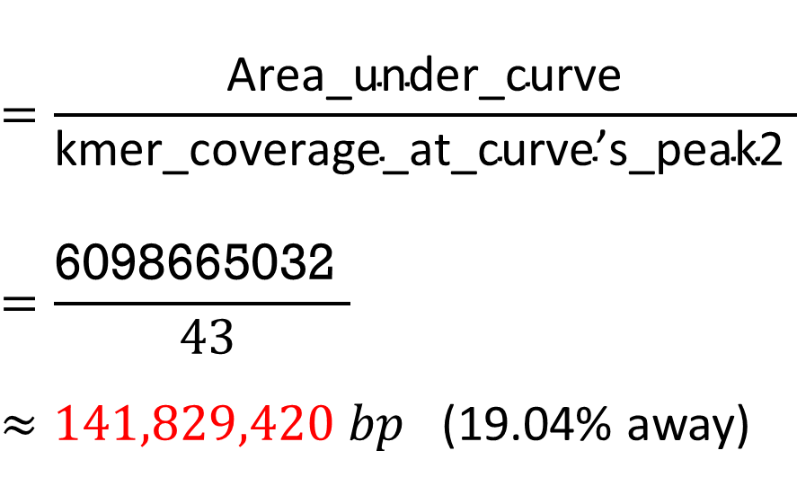
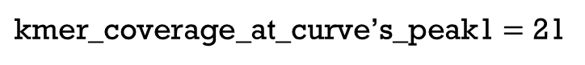
SRX1865253(Arabidopsis thaliana, 阿拉伯芥)
$G=\frac{N_{reads}×L}{C_{kmer}}$
Area_under_curve = 6098665032
$$=\frac{\text{Area}\text{_}\text{under}\text{_}\text{curve}}{\text{kmer}\text{_}\text{coverage}\text{_}\text{at}\text{_}\text{curve}\text{’}\text{s}\text{_}\text{peak}\text{2} }$$
$$=\frac{\text{6098665032} }{ 43}$$
$≈141,829,420 bp$ (19.04% away)
$\text{kmer}\text{_}\text{coverage}\text{_}\text{at}\text{_}\text{curve}\text{’}\text{s}\text{_}\text{peak}\text{1}=$ 21
NCBI_genome: 119,148,000 bp
$$\text{kmer}\text{_}\text{coverage}\text{_}\text{at}\text{_}\text{curve}\text{’}\text{s}\text{_}\text{peak}\text{2}=43$$
Notes:
N(genome size) = Total no. of k-mers/Coverage = Area under curve /mean coverage;
This is not a haploid type (not homozygous) k-mer distribution, so there are two peaks at frequency=21 and frequency=43 respectively, where 21*2 almost equals 43.
Besides, here also avoids erroneous k-mers by excluding all k-mers occurring at frequencies smaller than certain value, which is at the valley of first peak’s right side, and here we use the frequency of second peaks as Coverage.
Therefore, the mean coverage is 43, and the area under curve is 6098665032. Finally, the genome size is 141,829,420bp, error rate = 19.04%.

Slide 7
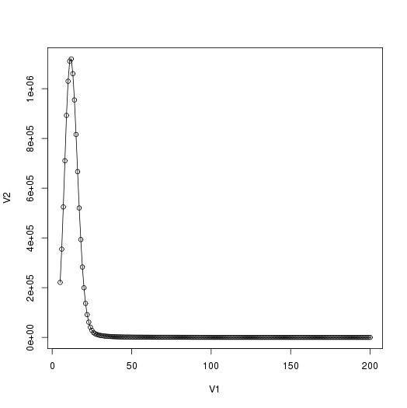
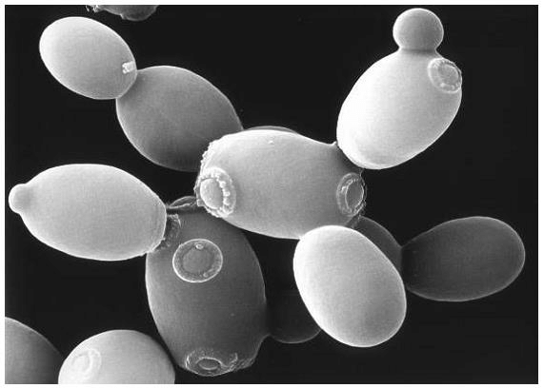
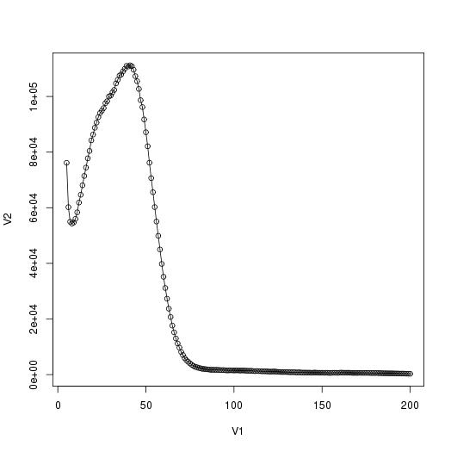
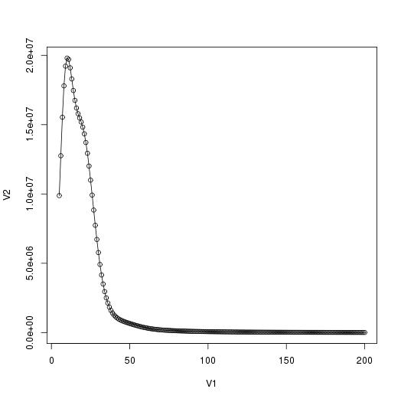
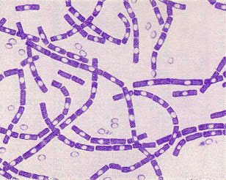
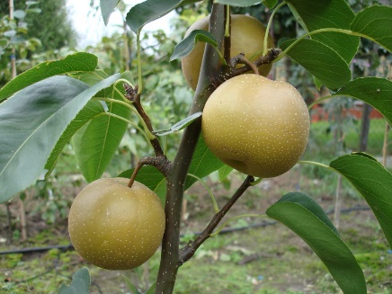
SRX1865253(Arabidopsis thaliana, 阿拉伯芥)
ERR038858 (Saccharomyces cerevisiae, 釀酒酵母)
DRR000183(Bacillus anthracis, 炭疽桿菌)
SRR609905 (Pyrus,bretschneideri, 鴨梨)
Notes:
N(genome size) = Total no. of k-mers/Coverage = Area under curve /mean coverage

Slide 8

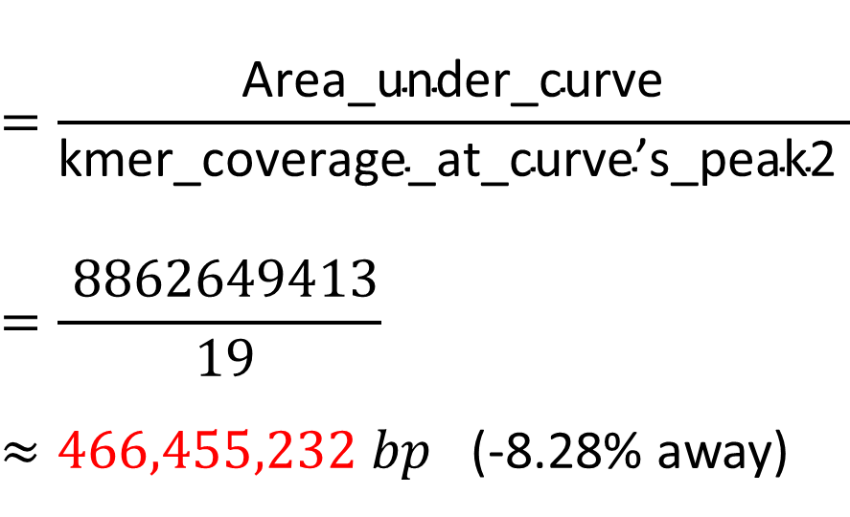
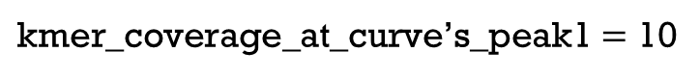
SRR609905 (Pyrus,bretschneideri, 鴨梨)
$G=\frac{N_{reads}×L}{C_{kmer}}$
Area_under_curve = 8862649413
$$=\frac{\text{Area}\text{_}\text{under}\text{_}\text{curve}}{\text{kmer}\text{_}\text{coverage}\text{_}\text{at}\text{_}\text{curve}\text{’}\text{s}\text{_}\text{peak}\text{2} }$$
$$=\frac{ 8862649413}{ 19}$$
$≈466,455,232 bp$ (-8.28% away)
$\text{kmer}\text{_}\text{coverage}\text{_}\text{at}\text{_}\text{curve}\text{’}\text{s}\text{_}\text{peak}\text{1}=$ 10
NCBI_genome: 508,551,000 bp
$$\text{kmer}\text{_}\text{coverage}\text{_}\text{at}\text{_}\text{curve}\text{’}\text{s}\text{_}\text{peak}\text{2}=19$$
Notes:
This is very high heterozygous one, because the peak 1 is higher than peak 2, and these two peaks are very near and almost merged. and the second peaks is estimated at around 20. Therefore, N(genome size) = Total no. of k-mers/Coverage = 10458904344 / 20 = 522,945,217bp, Error rate = 2.1%. (512,000,000 bp, from Genome Res. 2013 Feb;23; Genome Haploid Length is 407,327,190 bp, from genomescope, http://qb.cshl.edu/genomescope/analysis.php?code=XJbpM1il3XyrYNAfOM4c).

Slide 9
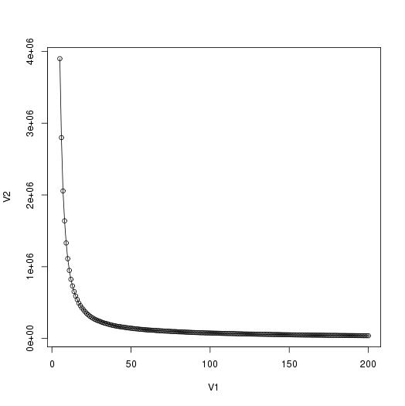
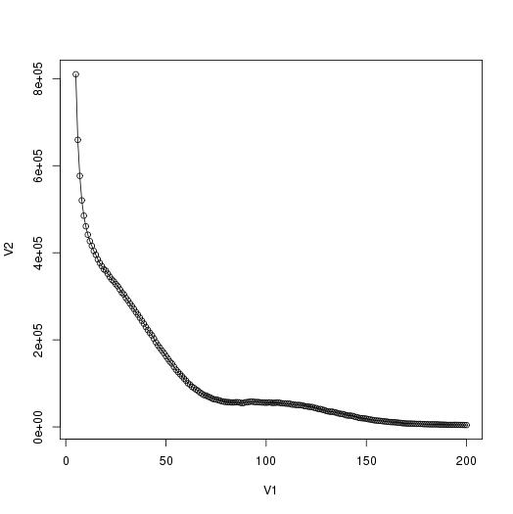
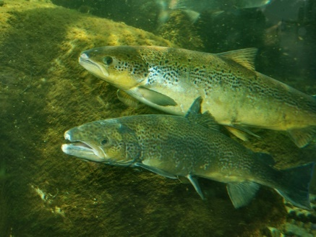
SRX1865253(Arabidopsis thaliana, 阿拉伯芥)
ERR038858(Saccharomyces cerevisiae, 釀酒酵母)
SRR2000035(Arabidopsis thaliana, 阿拉伯芥)
Unable to analysis
(no peaks appear)
(Bacillus anthracis, 炭疽桿菌)
SRR609905(Pyrus,bretschneideri, 鴨梨)
ERR070478(Salmo salar, 大西洋鮭)
Unable to analysis
(no peaks appear)
Notes:
N(genome size) = Total no. of k-mers/Coverage = Area under curve /mean coverage

Slide 10
Using GenomeScope Model’s method
Notes:
Tools:
Jellyfish (Marcais and Kingsford, 2011) -> to count kmers directly from raw NGS reads.
Genomescope (Gregory and Michael, 2017) -> apply a specific mathematical model to assist the analysis of k-mer distribution.

Slide 11
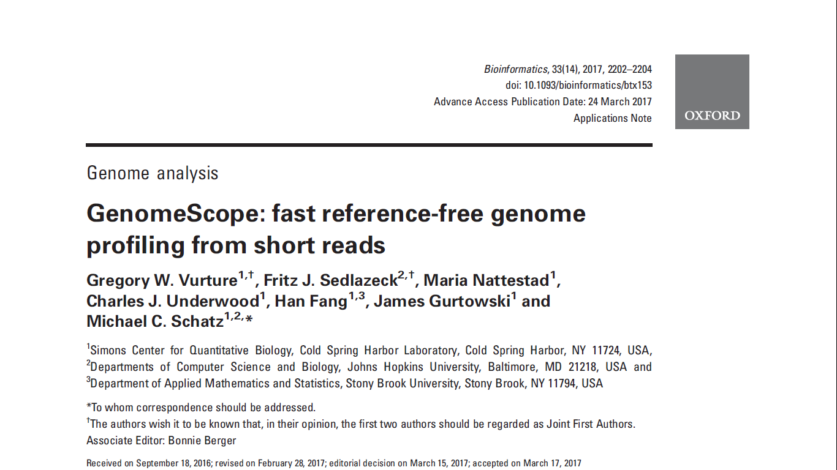
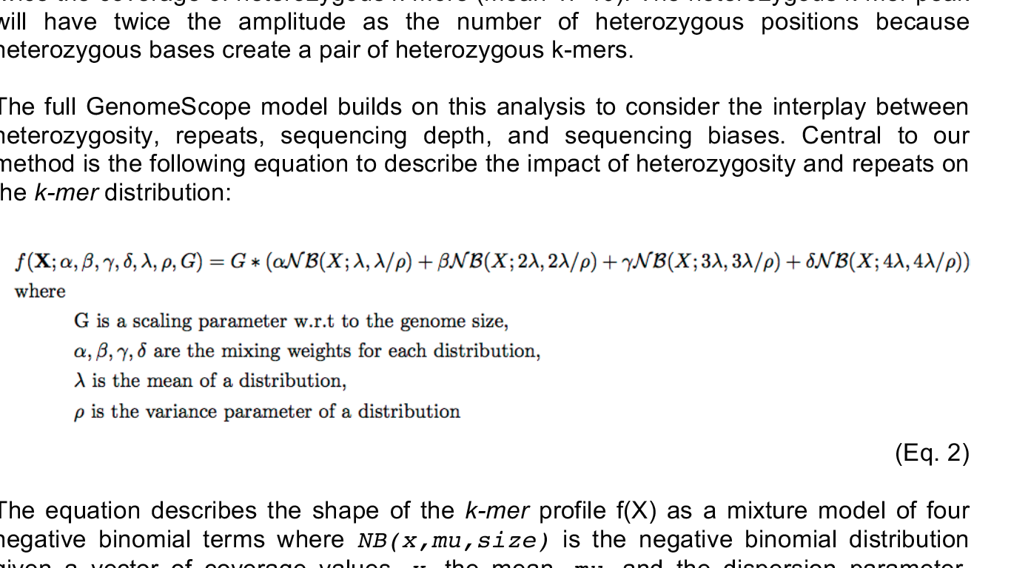
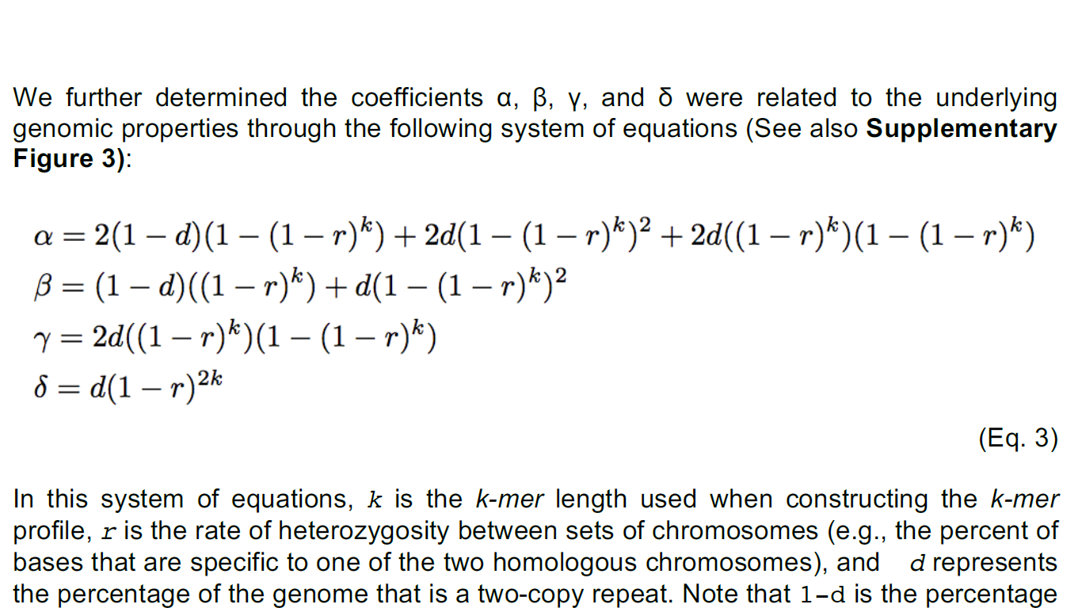
Notes:
Model’s mathematic formula.

Slide 12
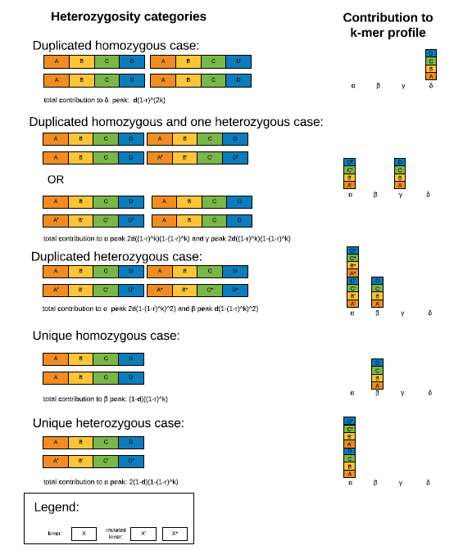
From: GenomeScope: fast reference-free genome profiling from short reads
Bioinformatics. 2017;33(14):2202-2204. doi:10.1093/bioinformatics/btx153
Bioinformatics | © The Author 2017. Published by Oxford University Press. All rights reserved. For Permissions, please e-mail: journals.permissions@oup.com
Notes:
The theory to construct the model:
Please refer the details to the target paper.

Slide 13
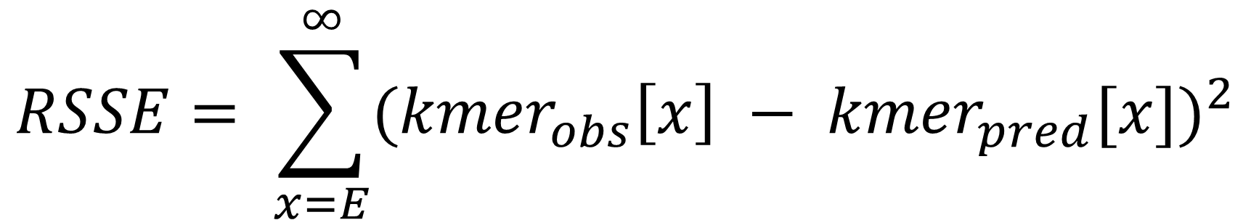
Calculate the fittest model:
$$RSSE= \sum_{x=E}^{∞}{{({kmer}_{obs}\left[x\right] − {kmer}_{pred}[x])}^{2}}$$
Choose the smallest RSSE model and prefer to select the model parameters that have higher rates of heterozygosity and smaller genome size .
Notes:
The final model parameters are decided by selecting the smallest residual sum of square error (RSSE) between the predicted values and the observed values (excluding presumptive sequencing errors with low coverage below specific threshold).
In the event of a near tie in RSSE, the algorithm selects the model parameters that have higher rates of heterozygosity and smaller genome size rather than lower heterozygosity and larger genome size.

Slide 14
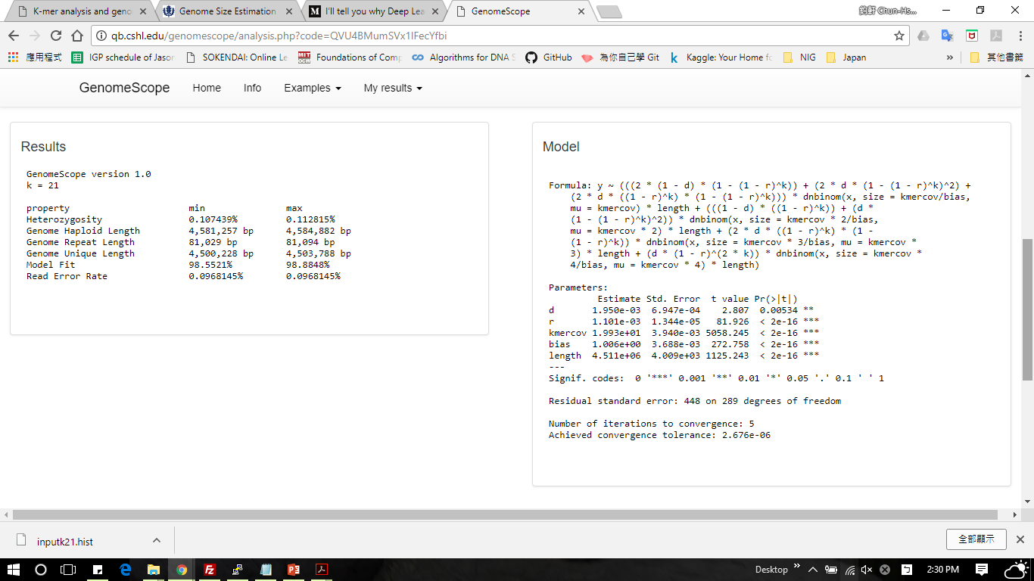
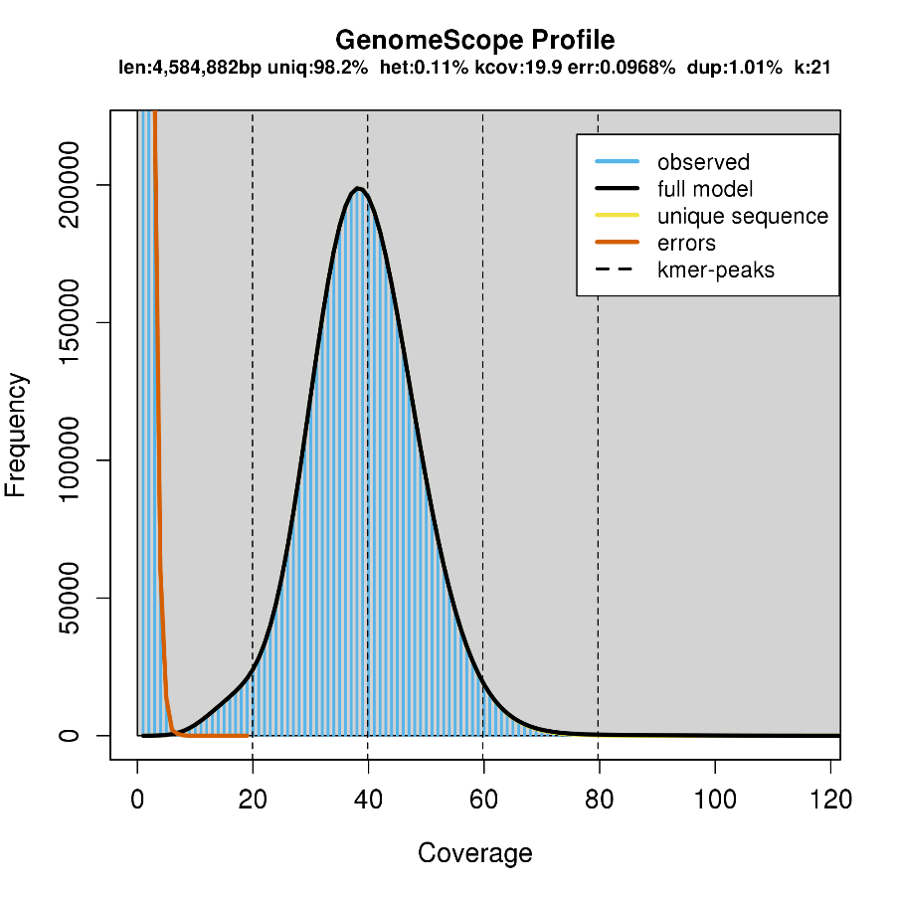
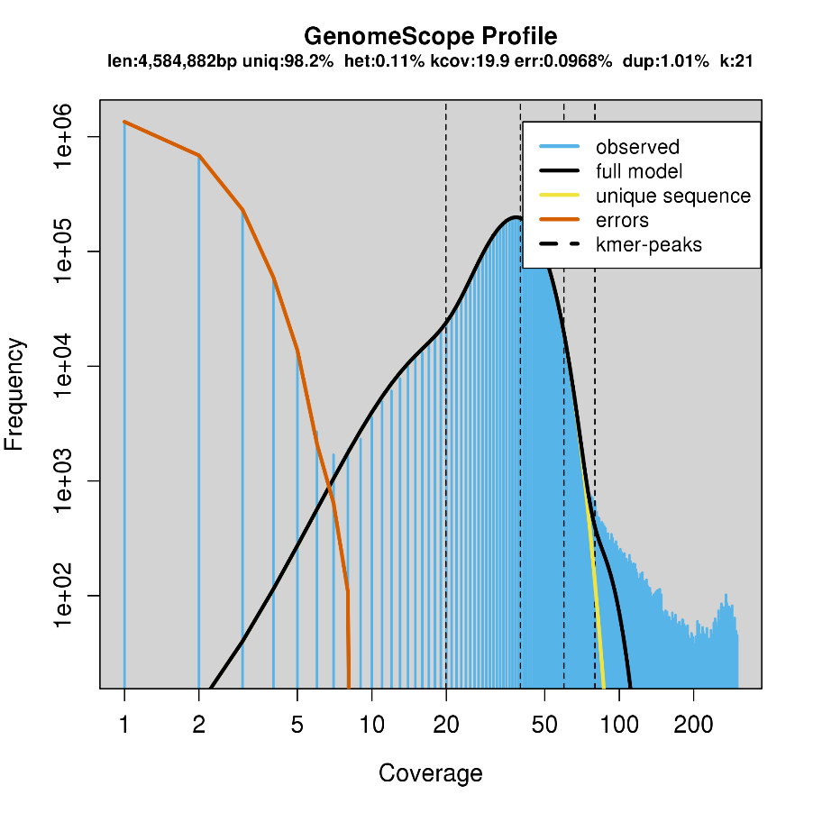
Visualize the model:
The x-axis, is the frequency or the number of times a given k-mer is observed in the sequencing data.
The y-axis, is the total number of k-mers with a given frequency.
Notes:
Visualize the model:
The x-axis, is the frequency or the number of times a given k-mer is observed in the sequencing data.
The y-axis, is the total number of k-mers with a given frequency.
Notice those k-mers that are not captured by the model and the erroneous k-mers.

Slide 15
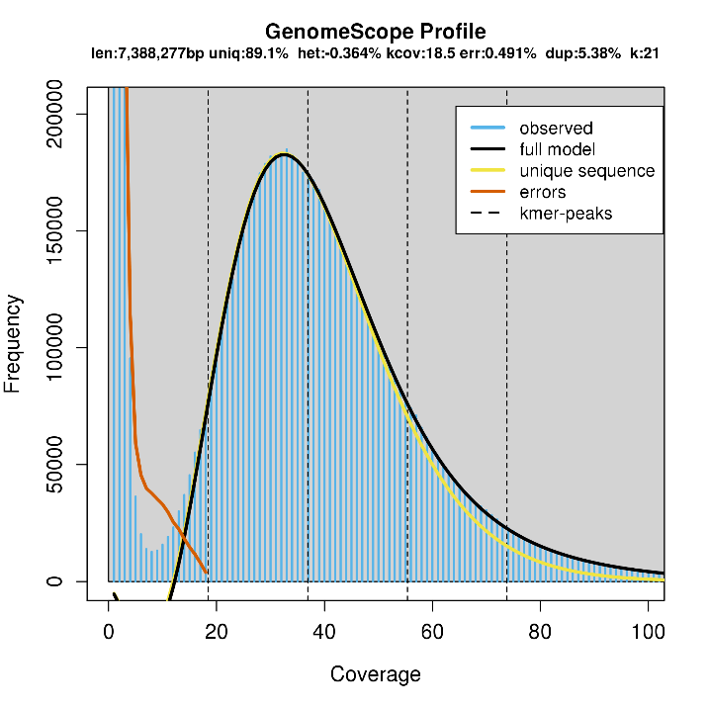
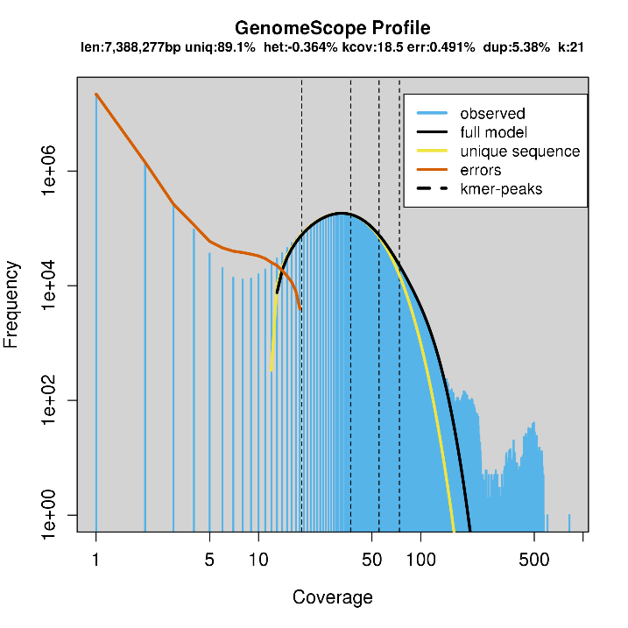
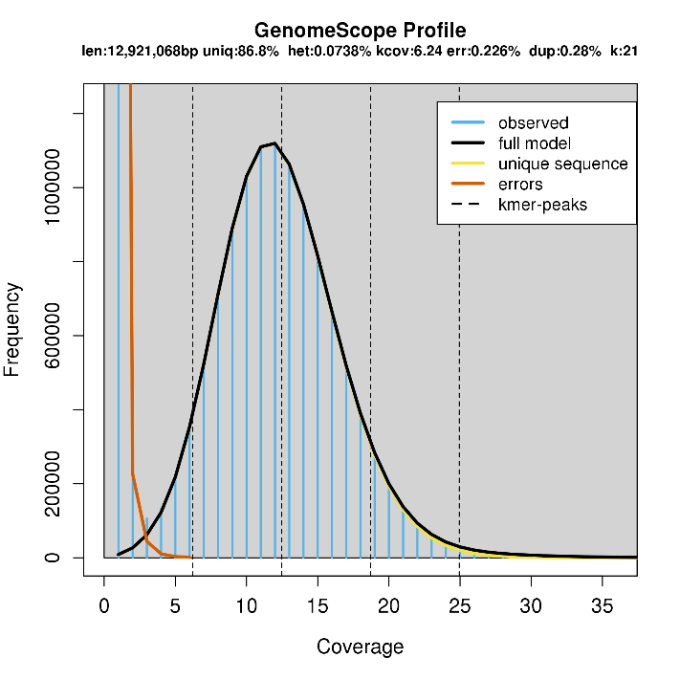
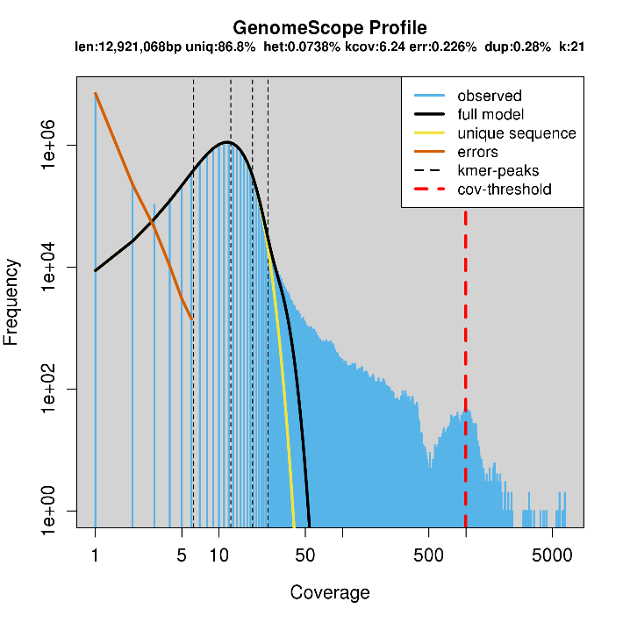
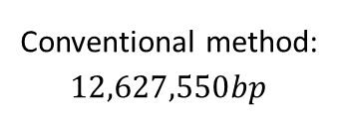
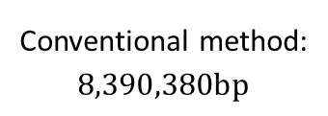
DRR021838 (Pseudomonas aeruginosa, 綠膿桿菌); Genome Haploid size: 7,388,277 bp
NCBI: 6,601,410 bp
Conventional method:
$$8,390,380bp$$
ERR038858 (Saccharomyces cerevisiae, 釀酒酵母); Genome Haploid size: 12,921,068 bp
NCBI: 12,123,123 bp
Conventional method:
$$12,627,550bp$$
Notes:
For single peak model

Slide 16
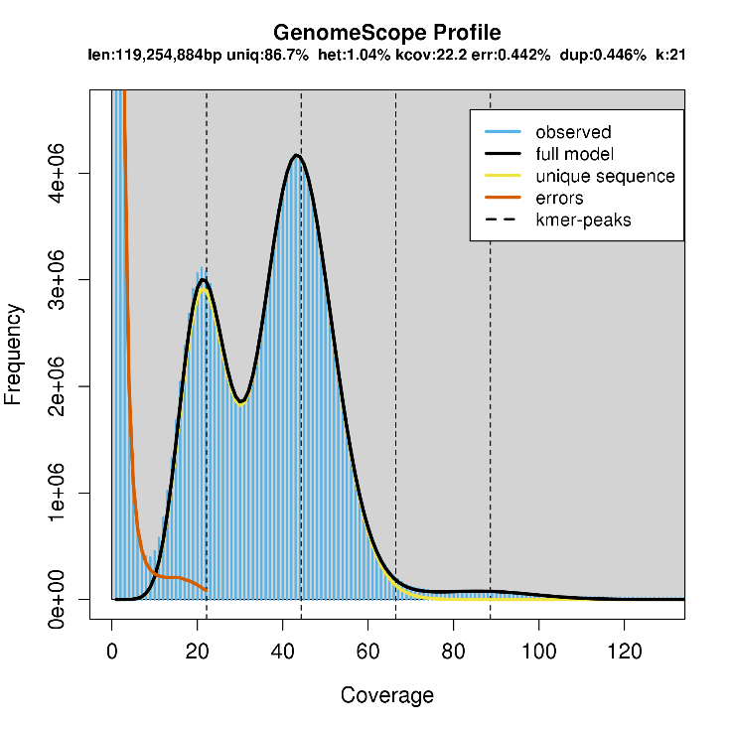
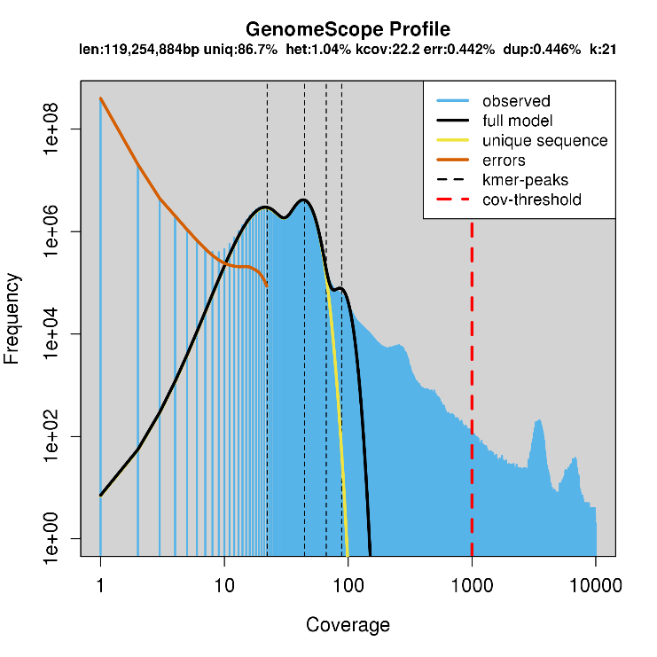
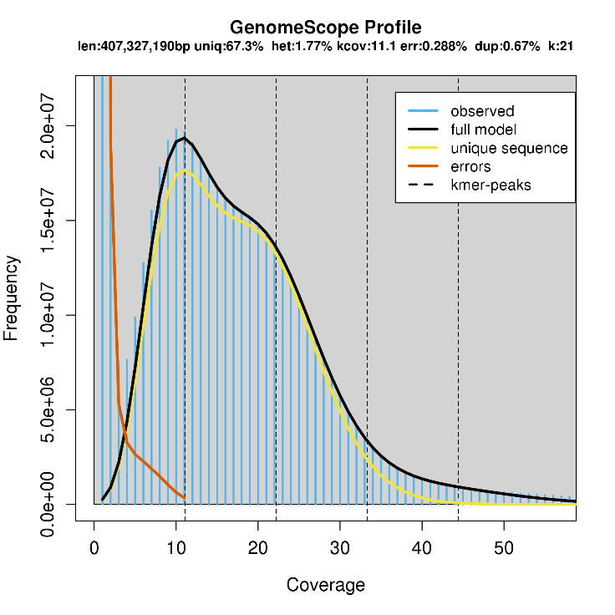
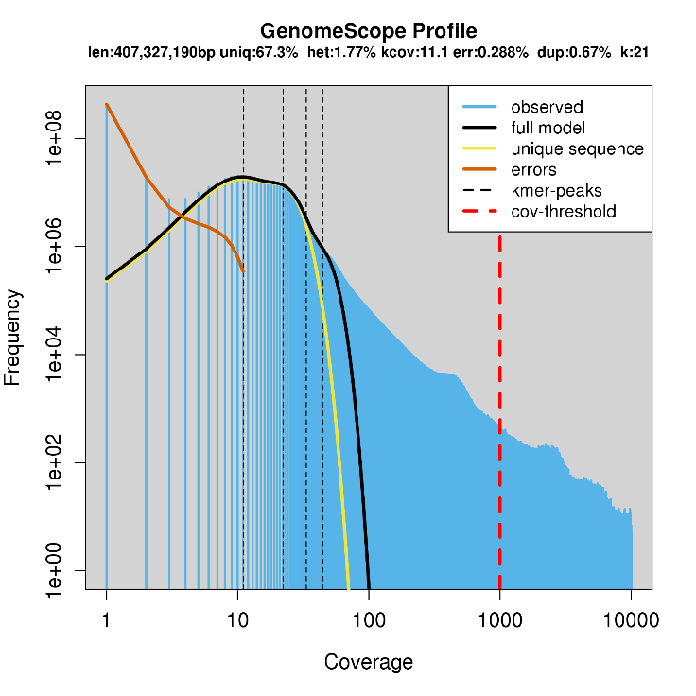
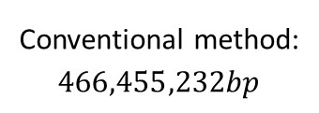
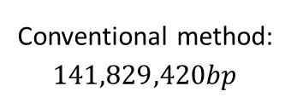
SRX1865253(Arabidopsis thaliana, 阿拉伯芥); Genome Haploid size: 119,254,884 bp
NCBI: 119,148,000 bp
Conventional method:
$$141,829,420bp$$
SRR609905 (Pyrus,bretschneideri, 鴨梨); Genome Haploid size: 407,327,190 bp
NCBI: 508,551,000 bp
Conventional method:
$$466,455,232bp$$
Notes:
For double peaks model

Slide 17
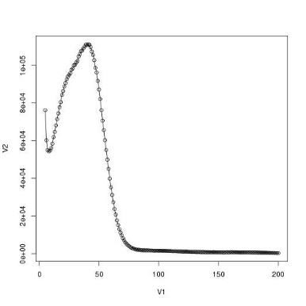
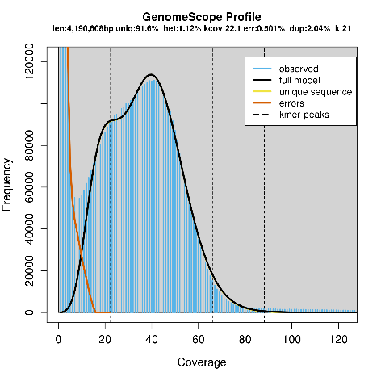
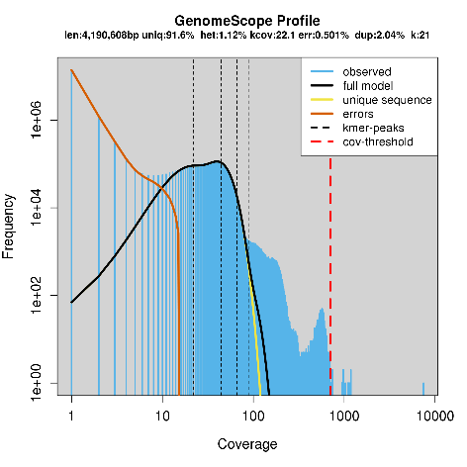
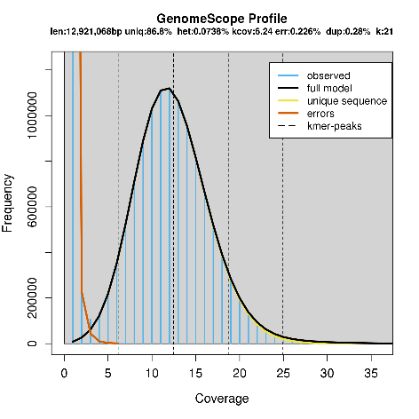













Success to fit the model (able to be analyzed)

Slide 18




SRR2000035(Arabidopsis thaliana, 阿拉伯芥); Unable to fit the model
Unable to analysis
ERR070478(Salmo salar, 大西洋鮭); unable to fit the model
Unable to analysis

Slide 19


















Fail to fit the model (unable to be analyzed)

Slide 20
The reason of model fail
Qualify of sequencing machine or samples:
Sequence data file contains too much sequencing error. (the left most peaks grows higher)
Genome coverage for sequence reads is too low. (If it’s under 50X; However, usually 100X.)
The genome’s instinct:
Target genome contains too many repeat sequences. (the right side tail grow longer)
Organelles’ genome may distort the k-mer’s profile. (usually occurring in plants)
Fail to be applied to multi-ploid organism. (genomescope is designed for diploid genome)
But still mainly depends on the quality of sequence file and method…

Slide 21





DRR015806 (Escherichia coli, 大腸桿菌)
Area_under_curve = 831656247
Genome Haploid size: 5,977,249 bp
$$\text{kmer}\text{_}\text{coverage}\text{_}\text{at}\text{_}\text{curve}\text{’}\text{s}\text{_}\text{peak}=162$$
$$G=\frac{N_{reads}×L}{C_{kmer}}=\frac{\text{Area}\text{_}\text{under}\text{_}\text{curve}}{\text{kmer}\text{_}\text{coverage}\text{_}\text{at}\text{_}\text{curve}\text{’}\text{s}\text{_}\text{peak}\text{2} }$$
$≈5,133,680 bp$ NCBI_genome: 5,147,720 bp
Notes:
For right-hand deviated model

Slide 22





DRR002192 (Homo sapiens, 智慧人)
Genome Haploid size: 46,899,943 bp
Area_under_curve = 15227857929
$$G=\frac{N_{reads}×L}{C_{kmer}}=\frac{\text{Area}\text{_}\text{under}\text{_}\text{curve}}{\text{kmer}\text{_}\text{coverage}\text{_}\text{at}\text{_}\text{curve}\text{’}\text{s}\text{_}\text{peak}\text{2} }$$
$≈3,045,571,586bp$
NCBI_genome: 2,996,420,000 bp
$$\text{kmer}\text{_}\text{coverage}\text{_}\text{at}\text{_}\text{curve}\text{’}\text{s}\text{_}\text{peak}=5$$
Notes:
For left-hand deviated model

Slide 23











(Homo sapiens,智慧人)
NCBI: 2,996,420,000 bp
DRR002191
Unable to fit the model
DRR002192
Genome Haploid size: 46,899,943 bp
DRR002193
Unable to fit the model
DRR002194
Unable to fit the model
Notes:
Genome scope model doesn’t fit well in this case…

Slide 24
Future works
Introduce machine learning method to analyze k-mer histogram.
Furtherly deep learning…
[Machine Learning is the] field of study that gives computers the ability to learn without being explicitly programmed.
—Arthur Samuel, 1959

Slide 25


Future works
Input: kmer histogram.
Output: genome feature.
prediction model: automatically constructed by AI.
Deep Neural Networks
Convolutional Neural Networks
Recurrent neural network
Notes:
Output genome feature can include:
Heterozygosity rate.
Genome haploid rate and length.
Genome repeat rate and length.
Genome unique rate and length.
Sequencing error rate.

Slide 26
Future works
Others:
By supervised learning:
predict unknown organism’s genome size, heterozygosity, repeat sequences’ proportion…etc.
By unsupervised learning:
Cluster unidentified organisms’ genome…etc.
By semisupervised learning:
Classify sequencing file’s quality…etc.
By reinforcement learning:
Finding a better way to do de novo genome assembly…etc.

Slide 27
Thanks for the attention!
More details at my github…, ID : xji6486

